Slide 1
Los Angeles Housing Department
Douglas Barrera Ventura, Anasheh Parseghian, Luis G. Estrada, Luis A Blanco, Rida Fatima

Slide 2


Introduction
LOS ANGELES COUNTY FORECLOSURES ANALYSIS USING SAP CLOUD.
DATA OBTAINED FROM THE WEBSITE LACITY.ORG CONSISTS OF PROVIDED YEAR, LENDER CONTACT, PROPERTY ADDRESS, PROPERTY TYPE, AND PROPERTY MANAGEMENT CONTACT INFORMATION.
Data used pre-covid crisis 2019 vs covid crisis 2020.

Slide 3


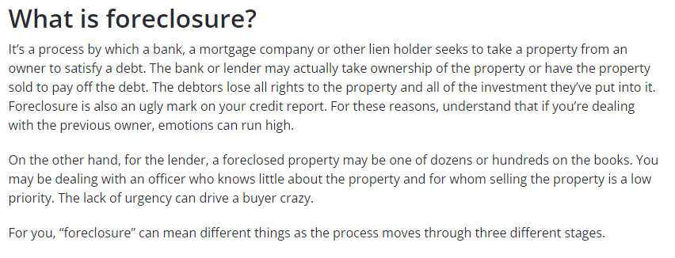

Slide 4
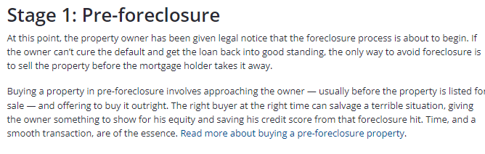
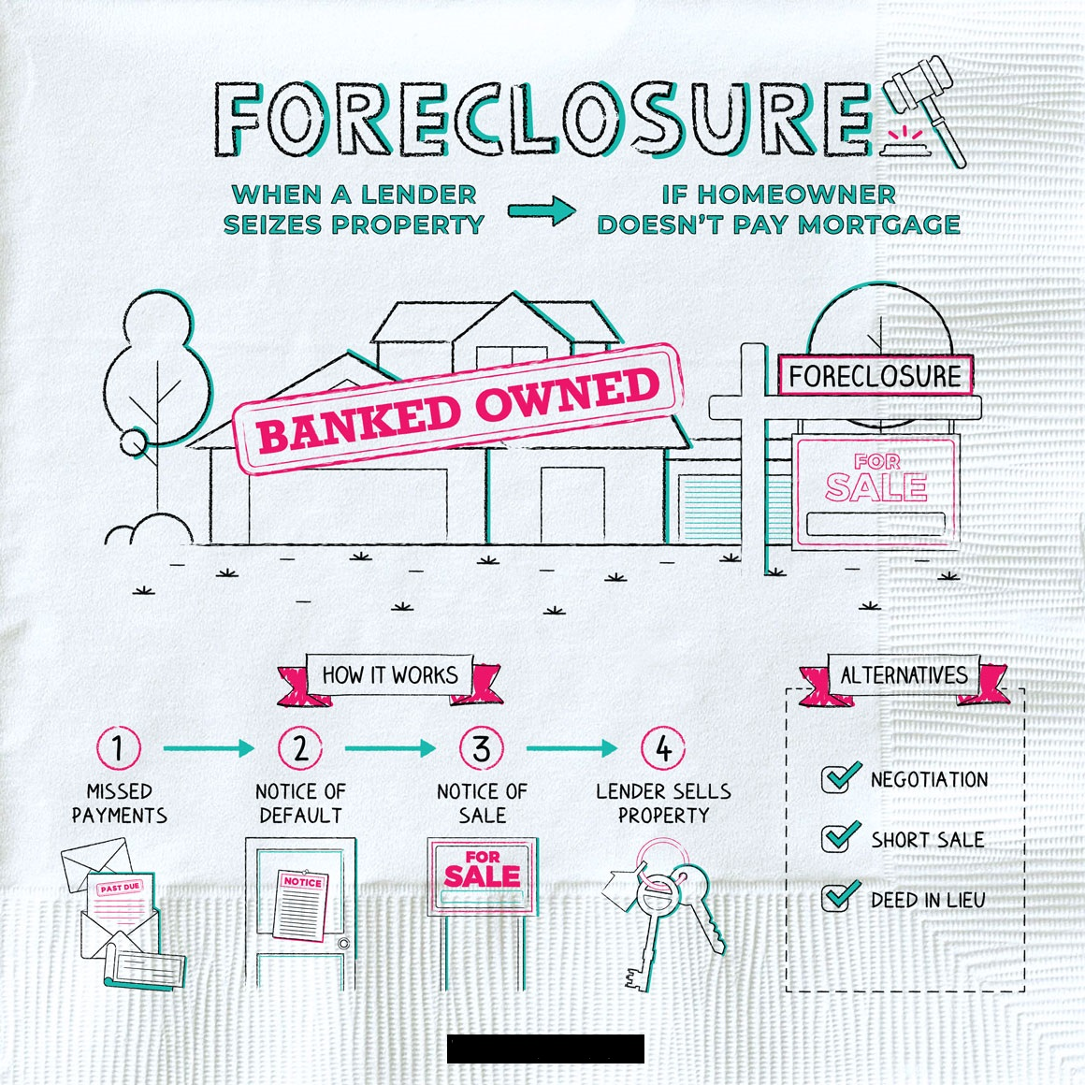
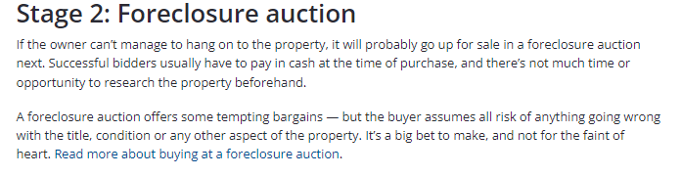
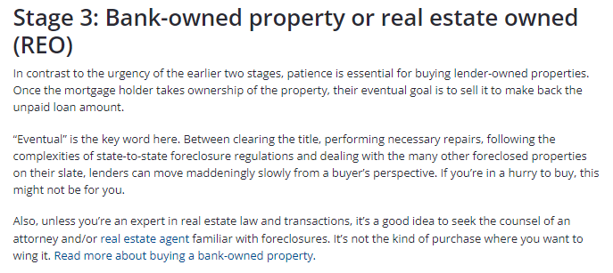
Foreclosure stages

Slide 5
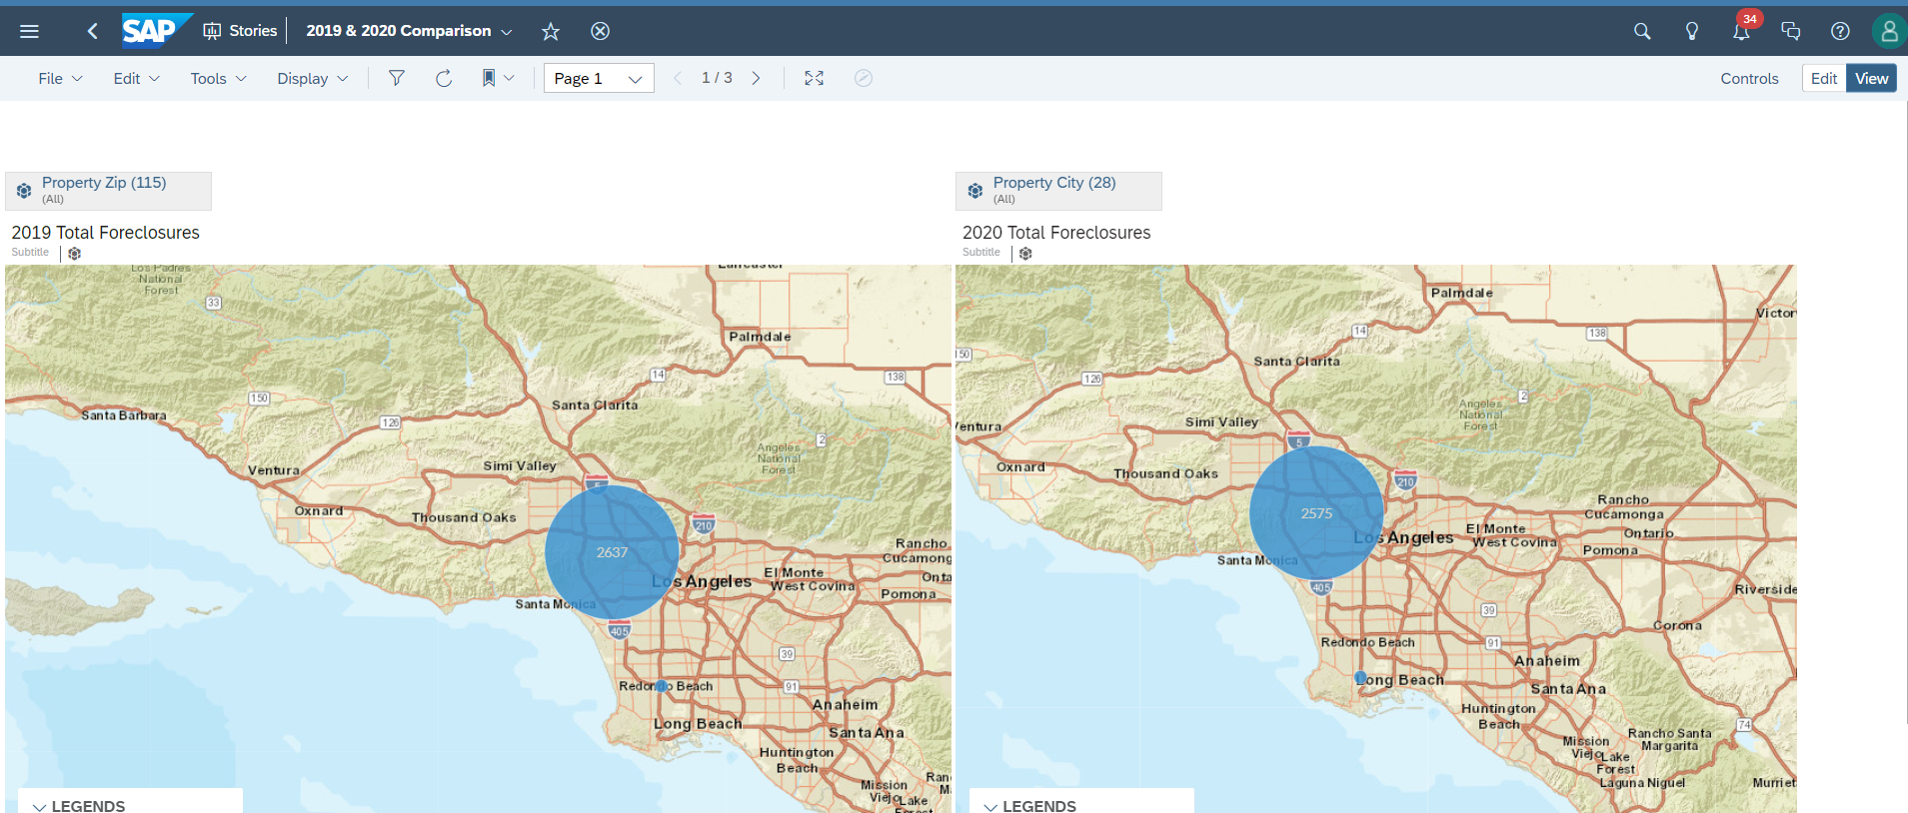
2019 vs. 2020 GEO Map of foreclose properties in LA county

Slide 6
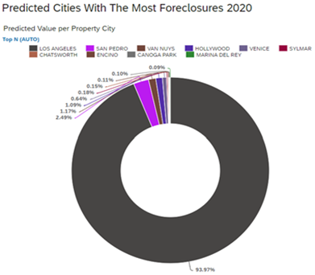
Value per property city

Slide 7
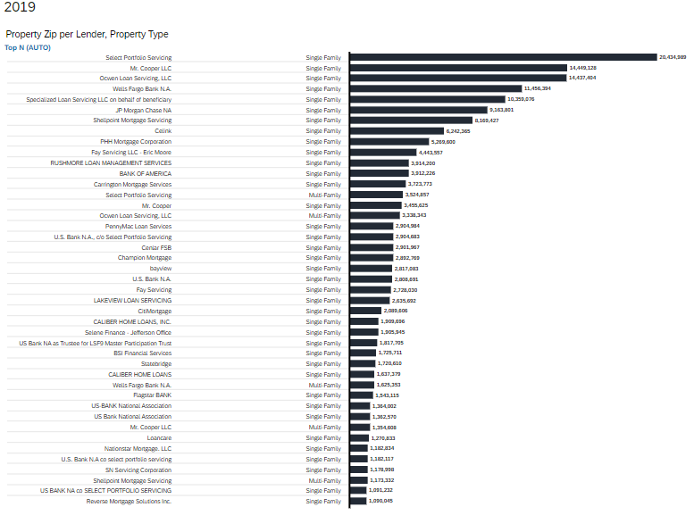
2019 Top LENDERS BAR CHARTS IN LOS ANGELES
Select Portfolio Servicing 20,434,247
Mr. Cooper, LLC. 14,449,128
Ocwen Loan Servicing, LLC. 14,437.424

Slide 8
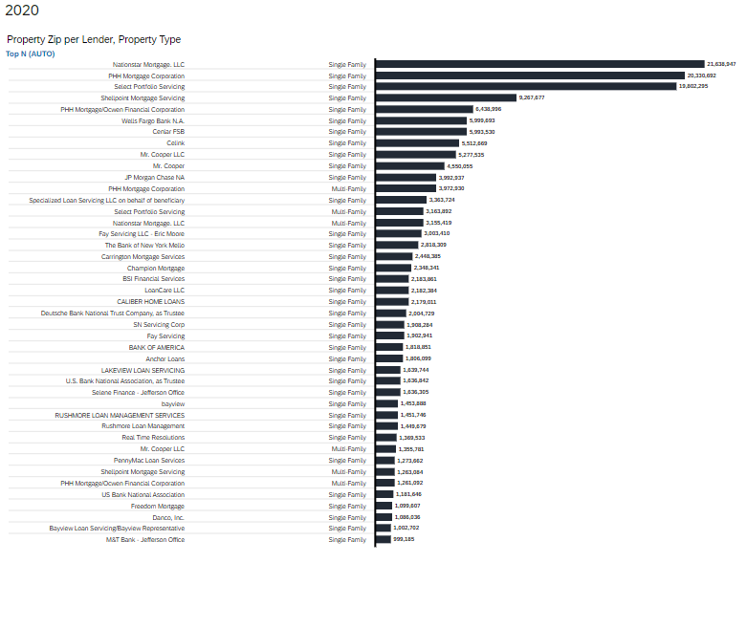
2020 Top LENDERS BAR CHARTS IN LOS ANGELES
Nationastar Mortgage, LLC. 21,638.247
PHH Mortgage Corp. 20,330,622
Select Portfolio Servicing. 19,802,295

Slide 9
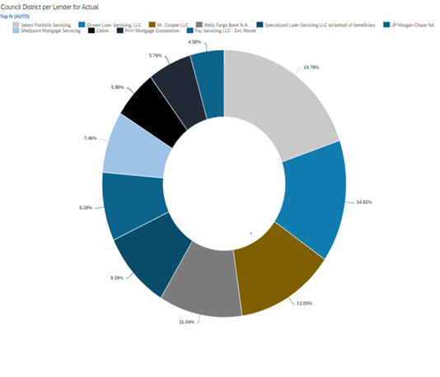
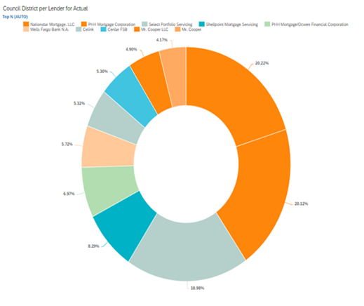
Top foreclosure companies
2019
Portfolio Servicing. 19.78%
Ocwne Loan Serices, LLC. 14.82%
Mr. Cooper LLC. 13.05%
2020
Nationstar Mortgage LLC. 20.22%
PHH Mortgage Corp. 20.12%
Portfolio Servicing. 18.98%

Slide 10
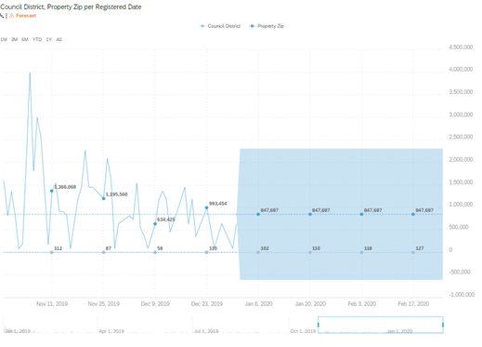
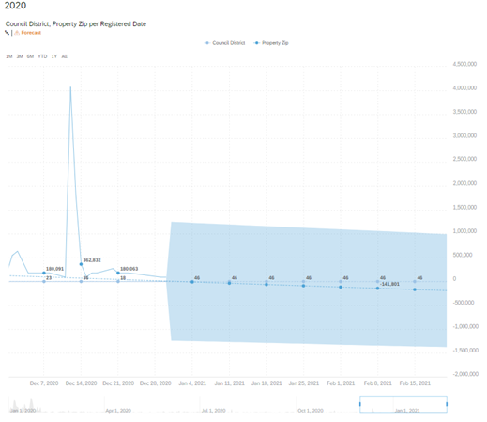
properties foreclosure forecast
2019
2020

Slide 11
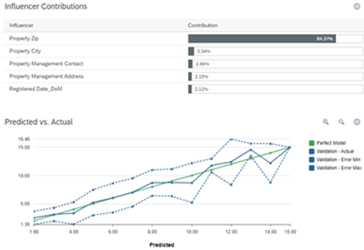
Los Angeles County foreclosure 2020 data predicted by city using regression analysis
Root means square error (RMSE) 2.28.
Prediction confidence 91.10%.

Slide 12
Reference
https://www.zillow.com/foreclosures/buyer/foreclosure-buying-overview/
https://data.lacity.org/Housing-and-Real-Estate/2019-Registered-Foreclosure-Properties/xwqr-9625
https://data.lacity.org/Housing-and-Real-Estate/2020-Registered-Foreclosure-Properties/9rv8-ayu5

Slide 13

Thank you

